Slide 1




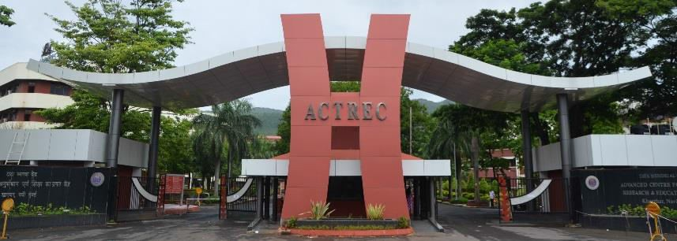
Chief Patron
Invitation to participate
Dr. Sudeep Gupta Director, ACTREC
Dear Colleagues,
We are pleased to invite you to participate in the 1st National Symposium on “Administrative Excellence” which is organised at ACTREC on 11 January 2020.
The theme of the symposium would revolve around management of Human Resources which is the most important aspect of any organization. One of the ways to initiate and bring the awareness amongst all our Officers, Investigators, Scientists, Sectional Heads, Administrative and HR staff of the institutions is by inviting vibrant and motivational HR speakers of eminence working in the related HR field.
We have shortlisted a few eminent HR speakers who will highlight work culture, talent management, leadership and innovative HR topics. This will be focused on the secrets behind the amazing employee culture and hence creating a healthier work ambience. The speakers will also talk on creating an inspiring work environment through adopting the idea of lifelong learning. They will focus on adapting to workplace trends by connecting in the digital age to unleash the power and perspective of next generation. This entire exercise of attending this unique symposium would be a continuous learning experience and a better plan for the new world of “Administrative Excellence”.
Patrons
1st National Symposium
on
Administrative Excellence
Dr. HKV Narayan,
Deputy Director, ACTREC
Dr. Navin Khattry, Deputy Director,
Clinical Research Centre, ACTREC
Dr. V. Prasanna, Deputy Director,
Cancer Research Institute, ACTREC
Conveners
Mr. A. N. Sathe, TMC
Mr. Umeshkumar Mote, ACTREC
11th January 2020
Co - Convener
ACTREC, Navi Mumbai
Mr. M. Y. Shaikh, ACTREC
Organizing Secretary
Mrs. Shilpa Sardesai
Mr. Devendra Pitale (Jt. Secretary)
Treasurer
Mrs. Anuradha Narayanan
Mr. Suryakanth Shedge (Jt .Treasurer)
Organizing Committee
Dr. Kishore Amin
Dr. Satish Munnolli
Dr. Ojaswini Upasani
Mr. Rajan Chavan
Mr. Shyam Chavan
Mr. Uday Dandekar
Mr. Prasad Kanvinde
Mr. Hrishikesh Kelkar
Mr. Hemant Mhatre
Mr. Arjun Patole
Mrs. Shraddha Deshmukh
Mrs. Kanchana Gopalkrishnan
Contact
Ms. Shilpa Sardesai & Mr. Devendra Pitale
Organizing Secretaries
Advanced Centre for Treatment, Research and Education in Cancer ; Tata Memorial Centre (TMC),
Sector 22, Kharghar, Navi Mumbai 410 210
Organized
by
ACTREC
Ph: 022-2740 5140 / 27405145
Email : administrativeexcellence@actrec.gov.in
Symposium website: https://symposiumactrec.wixsite.com/admin-excellence
Tata Memorial Centre (TMC)

Slide 2
About HR Management Symposium
Theme: - Human Resource (HR)
Registration
The First National Symposium on Administrative Excellence will be held on Saturday, the 11th of January 2020 at the Advanced Centre for Treatment, Research and Education in Cancer (ACTREC), Tata Memorial Centre (TMC) in Navi Mumbai. The symposium will be an excellent opportunity for the Managers, Supervisory and subordinate staff, Human Resource personnel, Administrative personnel multitasking on a variety of administrative portfolios. This unique symposium will focus on topics related to Human Resource and the prime objectives will be to share experiences, ideas, and boost the morale on all aspects of HR enabling to be projected on a solitary platform. The Administrative fraction of the human resource encompasses a variety of topics, but the most burning issues will be portrayed and discussed. The symposium will bring out value added experience by the stalwart, vibrant orators, which may be imbibed by the participants to make their parent organization a smooth functioning and an institution of excellence.
Essential HR skills for the Non HR Managers
Payment of Fees must accompany the Registration Form. Your registration WILL NOT be confirmed until payment is received in full. Payment must be made in Indian Rupees. Bank charges, if any, to be borne by the applicant. The fees are inclusive of GST. Registration fee is waived off for TMC participants but, filling-in the registration form is a must. For Registration Click Here
Human resource management (HRM or HR) is the strategic approach to the effective management of staff in an organization such that they help their objective gain a competitive advantage. It is designed to maximize employee performance in service.
Sub-Themes:
Imparting Leadership Quality
Achievers always may tend to impart their leadership quality either to their subordinates and groom them to be the next in line leaders.
Categories |  | Registration Fees
Professionals, Academic & Organizations |  | INR 1000
Corporates/Industries |  | INR 2000
Students |  | INR 500
Managing employee performance & discipline
While motivation is an individual concept, morale is a group concept. Thus, motivation takes into consideration the individual differences among the employees, and morale of the employees can be increased by taking those factors into consideration which influence group scenario or total work settings.
Bank Details (NEFT)
About ACTREC
Selecting the best Asset
Recruitment & Interviewing technique
Account Name: TATA MEMORIAL CENTRE-ACTREC
Bank Account Number: 1797305746 (Current Account)
Bank Name & Branch: Central Bank of India, Kharghar Branch, Navi Mumbai: IFSC Code: CBIN0284047
Please e-mail UTR No. to the Organizing Secretary, after transfer of funds.
The Advanced Centre for Treatment, Research and Education in Cancer (ACTREC) is the state of art of R&D wing of the Tata Memorial Centre, spread in a 60 acre terrain. It is located in the picturesque settings at the foothills of the Sahyadri hills in Kharghar, Navi Mumbai. ACTREC encompasses, the Cancer Research Institute (CRI), Clinical Research Centre (CRC) and Centre for Cancer Epidemiology (CCE). This unique setting is built in India and is evolved with a vision to provide comprehensive care, through its dictum of quality in services, education and research in Cancer. https://actrec.gov.in
Interviewing a candidate is always judged by the knowledge and relevant experience with the positive attitude towards a growing institution they posses. Monetary gains for a livelihood becomes secondary when an individual converts the stress related job into an ever growing challenge. This potential candidate becomes an asset to an institution.
Who should participate ?
The target audience for the symposium include personnel from Heads of Departments, Human Resource, Material Management, Finance, Watch & Ward, Fire Services, Scientists, Clinicians, Research Scholars, MBA, IT, Estate Management and Engineering Services.
Effective Communication
Effective communication is very important to organizations because it allows organisations to be condusive and operate effectively. Employees can experience an increase in morale, productivity and commitment if they are able to communicate up and down the communication chain in an organization.
About TMC
The Tata Memorial Centre (TMC) encompasses the Tata Memorial Hospital (TMH) and ACTREC. TMH is situated in Parel, Mumbai and ACTREC in Kharghar, Navi Mumbai. The Chief Administration Officer oversees the administration of both the organisations, which in turn is managed by the Senior Administrative Officers of TMC is an Autonomous body funded and controlled by the Department of Atomic Energy, (DAE), Government of India which also looks after the administration of both the institutions since 1962. https://tmc.gov.in
Dates to remember
Managing Stress
Last date for registration – 05th January 2020
Date of Symposium – 11th January 2020
Registration fees include lunch , high tea and a Kit.
Group Photo at 1.00pm
Accommodation- Limited for outstation candidates
Stress management in HR has many techniques and psychotherapies which are aimed at controlling a person's level of stress, especially chronic stress, for the purpose of improving everyday functioning in their work place. This exercise brings positive team spirit and accomplishes the task given by the superiors in an institution.

